Slide 1


Social Buzz

Slide 2


Today's agenda
Project recap
Problem
The Analytics team
Process
Insights
Summary

Slide 3

Social Buzz is a social media and content creation platform and emphasizes content
by keeping all users anonymous, only tracking user reactions on every piece of
content. Social Buzz has reached over 500 million active users each month. They
have scaled quicker than anticipated and need the help of an advisory firm to
than anticipated an oversee their scaling process effectively.
Accenture is running a three month initial project with the following objectives:
a). An audit of social buzz big data practice
b). Recommendations for a successful IPO
c). An analysis of Social Buzz content categories that highlights the top 5
categories with the largest aggregate popularity.
Project Recap

Slide 4


Problem
Analysis to find Social Buzz’s top 5 most popular categories of content.

Slide 5


Andrew Fleming
Chief Technical Architect
The Analytics team
Marcus Rompton
Senior Principle
Sona Maria Jacob
Data Analyst

Slide 6
Process
1
Data Understanding
2
Data Cleaning
3
Data Modeling
4
Data Analysis
5
Uncover Insights

Slide 7

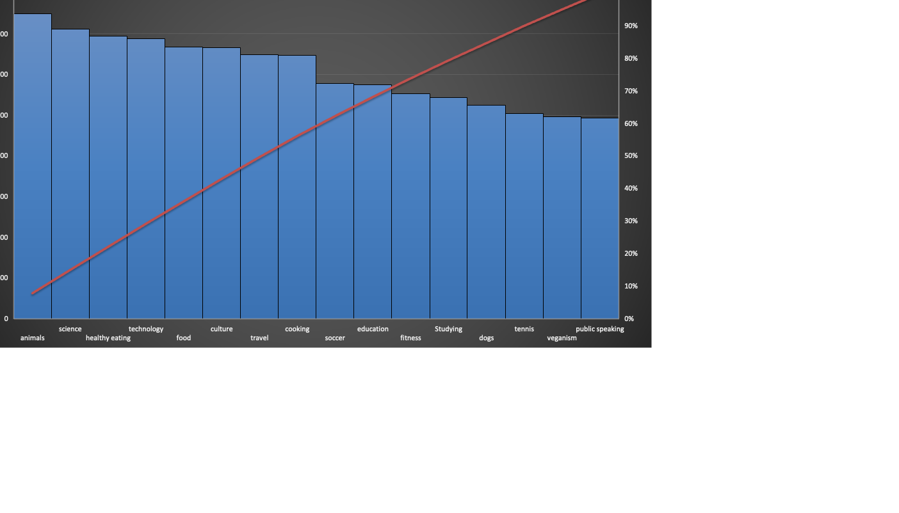
Insights
Animals, Science, Healthy Eating, Technology and food are the top 5 content categories.

Slide 8
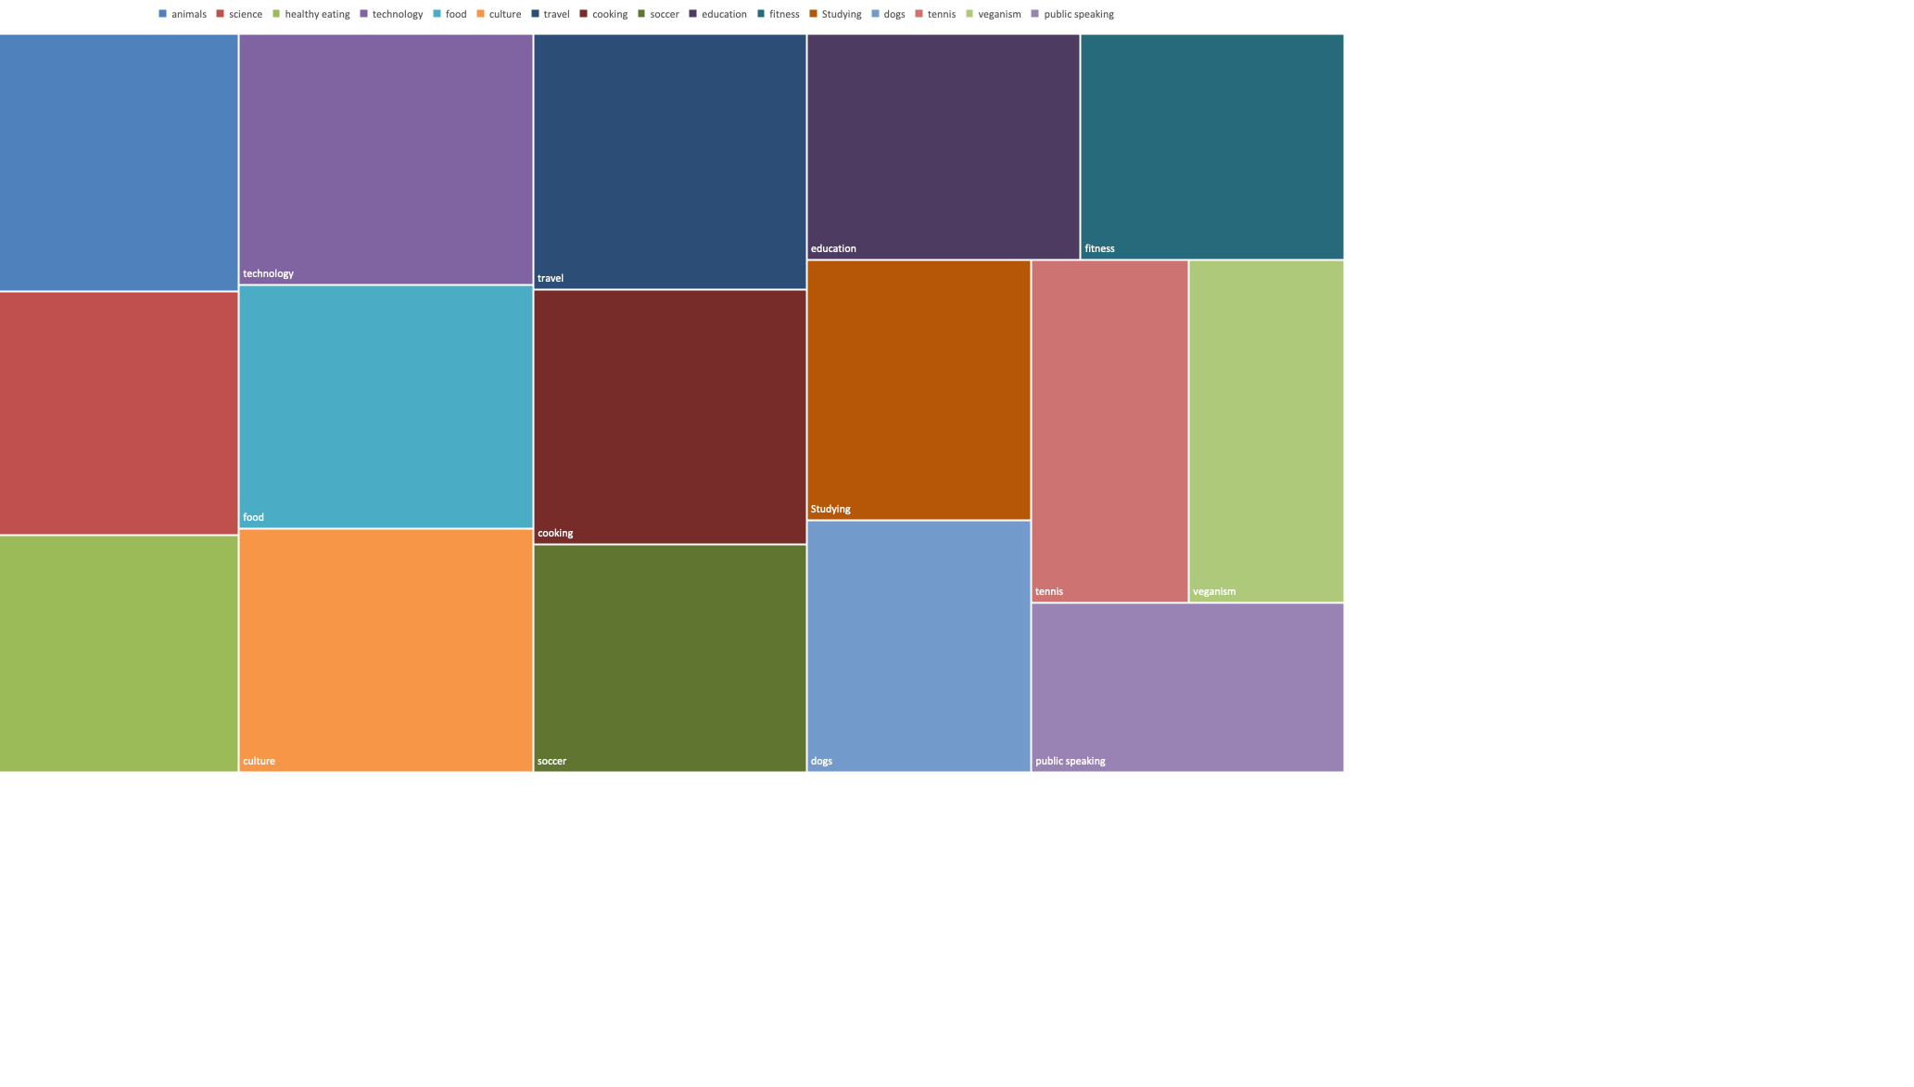
Unique Categories - 18

Slide 9
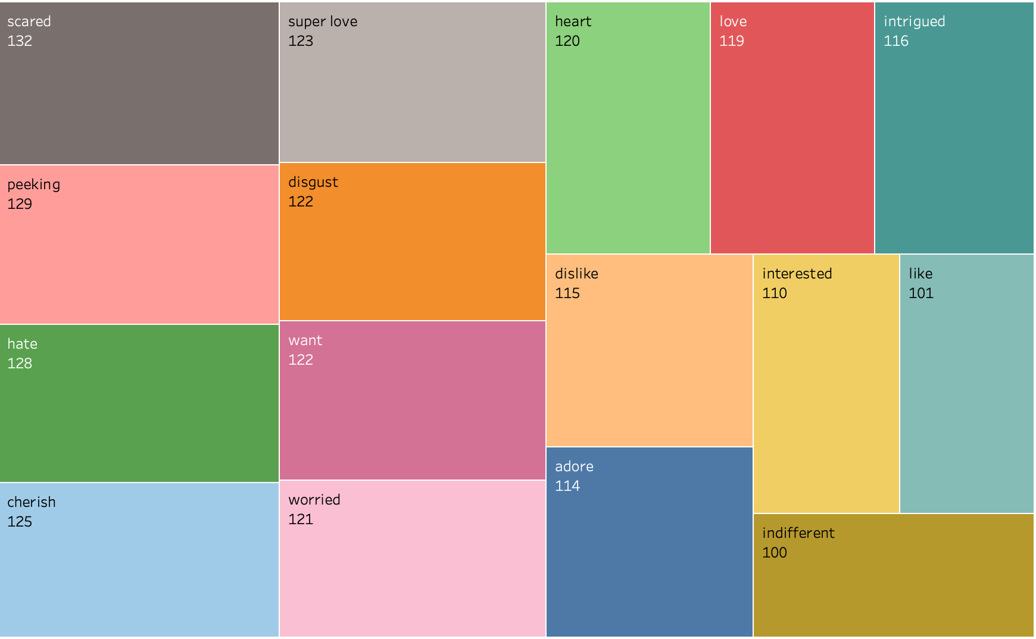
Animal is the most popular
category with 1897 reactions.

Slide 10
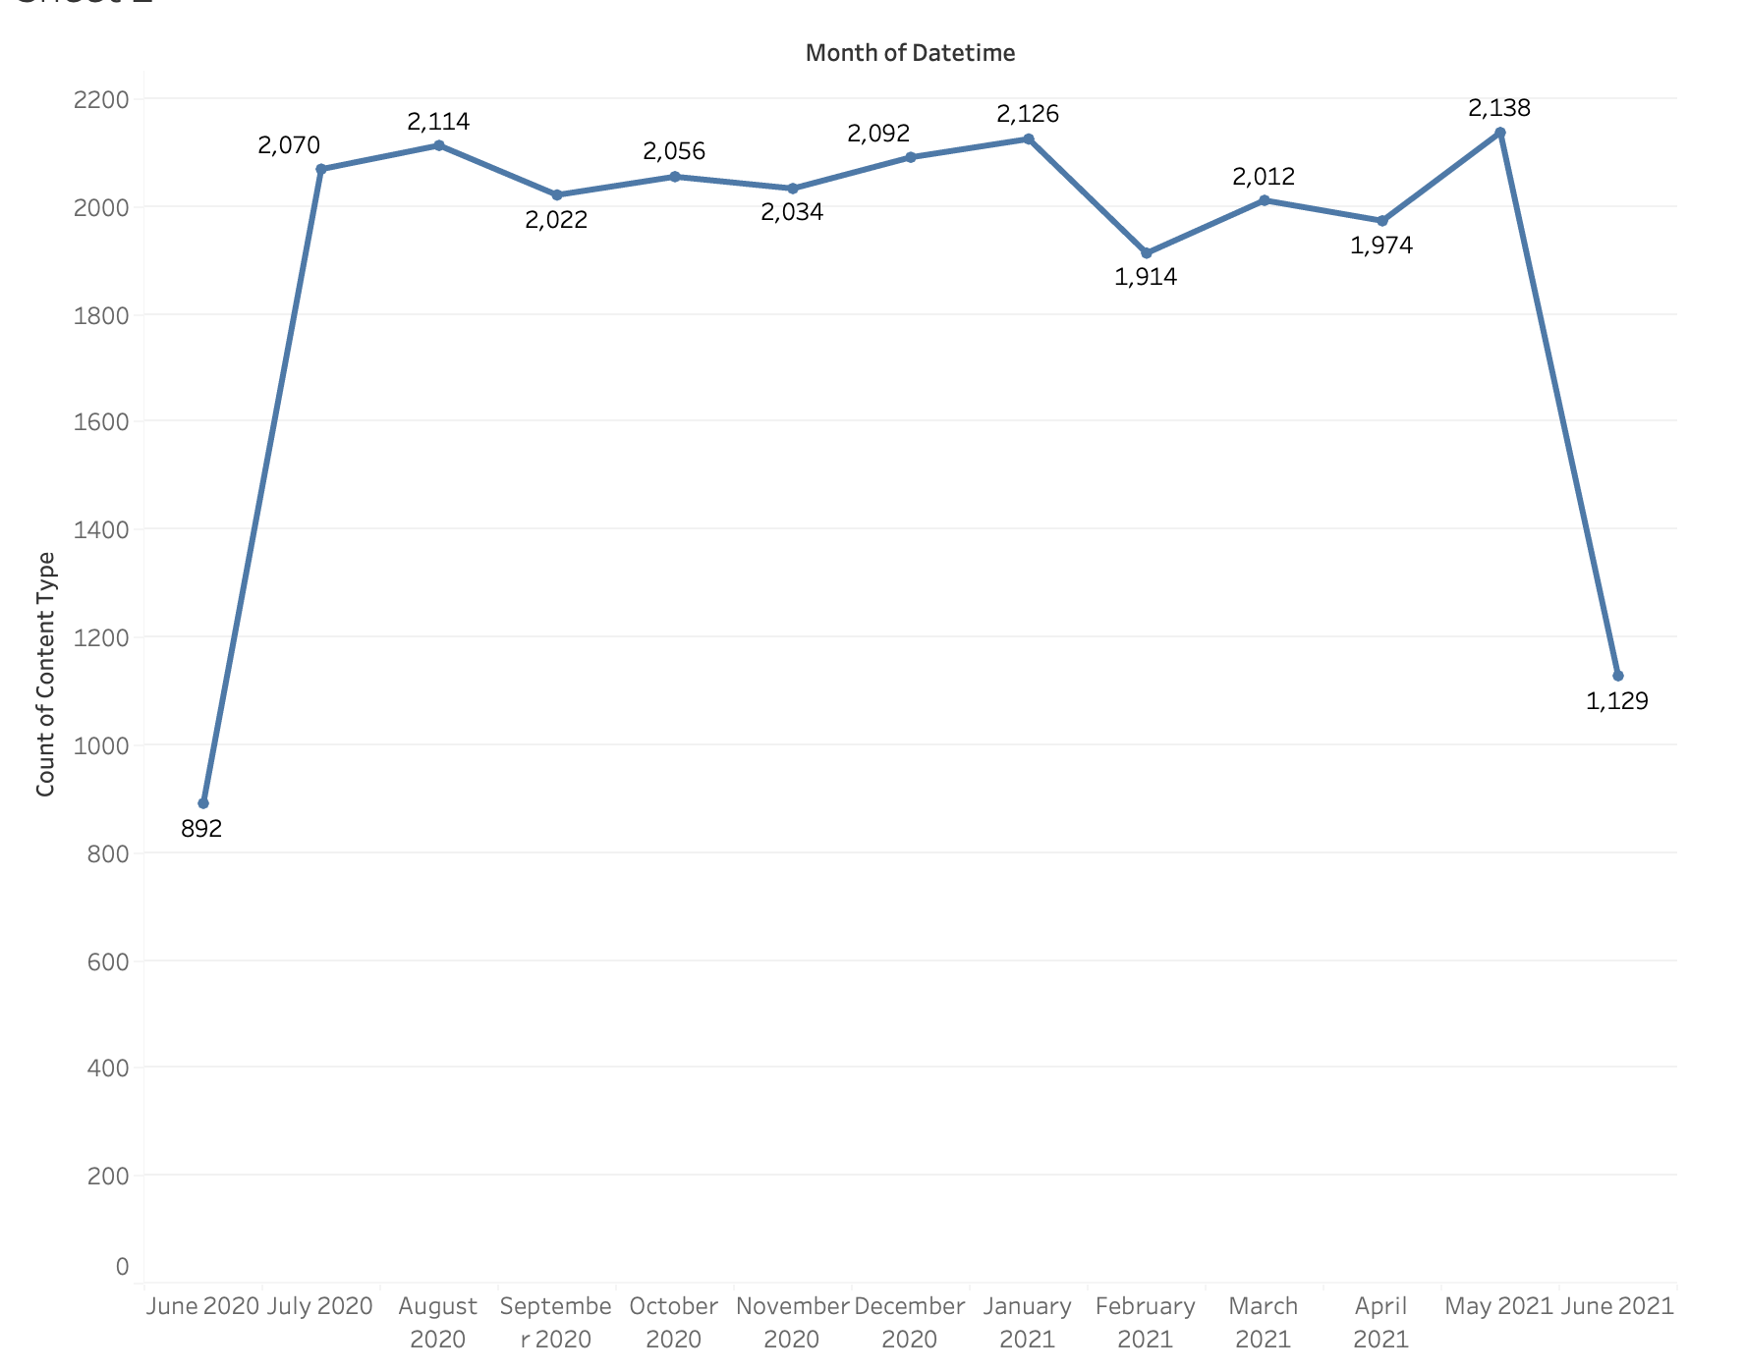

Slide 11

There are a total of 18 unique categories with ‘Animal’ being the most popular category with 1897 reactions.
Summary
In 2021, May was the month with most posts.
In 2020, August was the month with most posts.

Slide 12

Thank you!
ANY QUESTIONS?

